Slide 1
Contributions to Entity Component System and Scripting in Game Engines
A Practical Approach to Core Mechanics
João Henrique Schmidt de Carvalho
Advisor: Geraldo Xexeo

Slide 2
Introduction
1
One of the central architectural designs of most modern game engines is the Entity Component System (ECS)
It provides a extremly scalable but difficult, data-driven approach to manage game entities and behaviors.
Alongside it, scripting plays a pivotal role in enabling dynamic interaction with the engine with interpreted languages, such as Python, Lua, JS, among others.

Slide 3
Direct approach: Example
2
class MeshWithAudio extends Entity {
Mesh *m_mesh
Autio *m_audio
}
class LightWithAudio extends Entity {
Light *m_mesh
Autio *m_audio
}
class LightMeshWithAudio extends Entity {
Light *m_light
Mesh *m_mesh
Autio *m_audio
}
class SpriteWithTransform extends Entity {
Sprite *m_sprite
Transform *m_transform
}

Slide 4
Direct approach: Example
3
class Enemy extends MeshWithAudio
class Player extends MeshWithAudio
class Firefly extends LightWithAudio
class Lamp extends LightMeshWithAudio
class UID extends SpriteWithTransform

Slide 5
Example: Updating the Entities
4
For each Enemy
call updatePhysics
call checkCollisions
call move
call render
// etc
For each Player
call updatePhysics
call checkCollisions
call move
call render
// etc
For each Firefly
call move
call emmit
// etc

Slide 6
Problem: Polymorphism Overhead
5
Whenever you call a method of a base class or using interfaces, the call itself involves one indirect step before the actual code is reached.
In C++ this is called Dynamic Dispatch Overhead and it is caused by vTables

Slide 7
Problem: Dynamic Dispatch
6
At runtime the program needs to check inside the vTable what is the correct link between the virtual function and the actual function before performing the call

Slide 8
Problem: Memory Locallity
7
When iterating in the non ECS way, you are looping in the data of the entire object first before going to the next object.
For each Enemy
call updatePhysics
call checkCollisions
call move
call render
// etc
For each Enemy
call updatePhysics
call checkCollisions
call move
call render
// etc

Slide 9
Problem: Memory Locallity
8
When iterating in the non ECS way, you are looping in the data of the entire object first before going to the next object.
For each Enemy
call updatePhysics
call checkCollisions
call move
call render
// etc
For each Enemy
call updatePhysics
call checkCollisions
call move
call render
// etc

Slide 10
Problem: Memory Locallity
9
When iterating in the non ECS way, you are looping in the data of the entire object first before going to the next object.
For each Enemy
call updatePhysics
call checkCollisions
call move
call render
// etc
For each Enemy
call updatePhysics
call checkCollisions
call move
call render
// etc

Slide 11
Problem: Memory Locallity
10
It is possible to clearly see the cost by doing a simple test. Exempli gratia, writing a small loop to sum all elements of a matrix:
// sum all elements of matrix
For each column index j from 0 to colsA - 1
For each row index i from 0 to rowsA - 1
Add element A[i][j] to result
For each row index i from 0 to rowsA - 1
For each column index j from 0 to colsA - 1
Add element A[i][j] to result

Slide 12
Problem: Memory Locallity
11
It is possible to clearly see the cost by doing a simple test. Exempli gratia, writing a small loop to sum all elements of a matrix:
// sum all elements of matrix
For each column index j from 0 to colsA - 1
For each row index i from 0 to rowsA - 1
Add element A[i][j] to result
For each row index i from 0 to rowsA - 1
For each column index j from 0 to colsA - 1
Add element A[i][j] to result
A: 20000^2
t1 = x.xx
t2 = x.xx

Slide 13
Problem: Memory Locallity
12
It is possible to clearly see the cost by doing a simple test. Exempli gratia, writing a small loop to sum all elements of a matrix:
// sum all elements of matrix
For each column index j from 0 to colsA - 1
For each row index i from 0 to rowsA - 1
Add element A[i][j] to result
For each row index i from 0 to rowsA - 1
For each column index j from 0 to colsA - 1
Add element A[i][j] to result
A: 20000^2
t1 = 4.46s
t2 = 1.15s

Slide 14
Problem: Memory Locallity
13
A[0][0], A[0][1], A[0][2], ..., A[1][0], A[1][1], ...
This leads to cache misses because each element is further apart in memory. In the end, this just shows what is already known, it is better for the CPU to iterate over arrays that are contiguous in memory

Slide 15
Explaining the ECS method: Components
14
Games have objects, like: enemies, non-playable-characters, props, light sources, inventories, terrain, fluids, etc.
First step is to turn a complex object into many small structs, such as: Mesh, Audio, Sprite, Transforms, Velocity, Angular Velocity, Collision Box, Particles, Camera, etc.
Those structures are called components

Slide 16
Explaining the ECS method: Entity
15
There are different views for what constitutes an entity or what it's supposed to represent.
Definition used by Unity Engine: Entities are just indices which represent objects IDs. On C++ terms, it means that they are integers.

Slide 17
mp)
16
Entity 1 (NPC)
Entity 2 (Lamp)
Entity 3 (Rock)
Velocity Component
(0.2,0.3,0.0)
(1.2,0.1,0.0)
Transform Component
(0.0,0.0,0.0)
(2.8,5.7,3.8)
(9.6,5.8,1.2)
Sprite Component
(size, color and tiling factor)
(0.1,0.1)
(1.,1.,1.,1.), 1.0
(0.5,0.5)
(0.2,0.2,0.2,1.), 1.0
Arbitrary components from arbitrary entities filled with arbitrary data in a random order
Notes:
OBS: objetos ainda podem ser acessados completamente, mais tem um nível de complexidade a mais

Slide 18
Explaining the ECS method: System
17
Object can still be fully accessed if you search for the index 1
call getComponent velocity at index 1 // { (0.2,0.3,0.0) }
call getComponent transform at index 1 // { (0.0,0.0,0.0) }
call getComponent sprite at index 1 // { (0.1,0.1), (1.0,1.0,1.0,1.0), 1.0 }
At first glance increased the cost of retrieving the original data. We now have to do N function calls, with N being the number of components in our object.

Slide 19
Explaining the ECS method: System
18
Let's consider the previous loop to update the enemy object:
For each Enemy
call updatePhysics
call checkCollisions
call move
call render

Slide 20
Explaining the ECS method: System
19
Let's consider the previous loop to update the enemy object:
For each Pyhsics Component // physics system
updatePhysics
For each Collision Component // collisions system
checkCollisions
For each Movement Component // movement system
move
For each Render Component // render system
render

Slide 21
Explaining the ECS method: System
20
Let's consider the previous loop to update the enemy object:
For each Pyhsics Component // physics system
updatePhysics
For each Collision Component // collisions system
checkCollisions
For each Movement Component // movement system
move
For each Render Component // render system
render

Slide 22
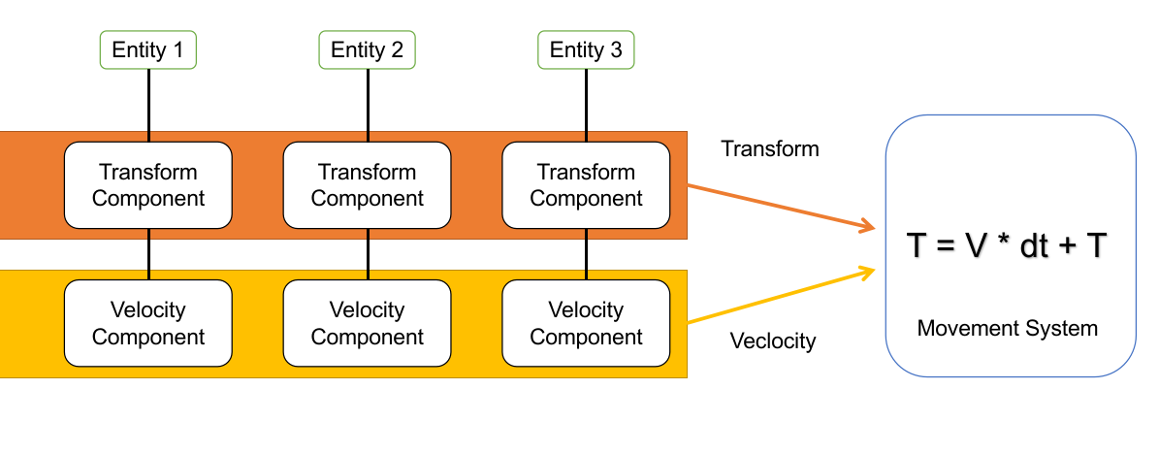
Explaining the ECS method: System
21

Slide 23
22
The code inside each loop is generally very specific, because its purpose is to update a very broad range of objects with a well-defined task:
A Physics System updates velocities based on gravity and other accelerations.
A Movement System updates positions based on velocities.
A Render System handles filling the batch rendering buffer
A Collision System calculates the intersection between collision boxes

Slide 24
Scripting: Using the ECS
23
After reviewing the ECS, anyone would be thinking on how hard it would be to replace the direct approach. After all, you must abstract based on behaviors of all entities, not based on individual objects.
For this comes scripting. For parts of the code that aren't critical, use a slower and easier approach that abstracts many specifications of your engine. That way, game/mod developers can quickly script what they want.

Slide 25
Scripting: Using the ECS
24
This solution is often used together with a scripting language, which also abstract the C++ to a more simple and friendly language, such as Python, Lua, C#, JavaScript, etc.
I have chosen Python. However, how to make it faster?

Slide 26
Scripting: Making it faster with Cython
25
import cython as c
@c.ccall
def factorial(x: c.int) -> c.int:
f: c.int = 1
i: c.int
for i in range(x):
f *= x - i
return f
@c.ccall
def testFactorial(n: c.int, x: c.int) -> c.void:
for _ in range(n):
factorial(x)
Tempos:
g++ -O0: x.xxxs
python: x.xxxs
cpython: x.xxxs

Slide 27
Scripting: Making it faster with Cython
26
import cython as c
@c.ccall
def factorial(x: c.int) -> c.int:
f: c.int = 1
i: c.int
for i in range(x):
f *= x - i
return f
@c.ccall
def testFactorial(n: c.int, x: c.int) -> c.void:
for _ in range(n):
factorial(x)
Tempos:
g++ -O0: 1.794s
python: x.xxxs
cpython: x.xxxs

Slide 28
Scripting: Making it faster with Cython
27
import cython as c
@c.ccall
def factorial(x: c.int) -> c.int:
f: c.int = 1
i: c.int
for i in range(x):
f *= x - i
return f
@c.ccall
def testFactorial(n: c.int, x: c.int) -> c.void:
for _ in range(n):
factorial(x)
Tempos:
g++ -O0: 1.794s
python: 224.333s
cpython: 0.535s

Slide 29
References
[1] R. E. Bryant and D. R. O’Hallaron, Computer systems: a programmer’s perspective, 2. ed. Boston, Mass.: Prentice Hall, 2011.
[2] M. Caini, skypjack/entt. (Oct. 23, 2024). C++. Accessed: Oct. 23, 2024. [Online]. Available: https://github.com/skypjack/entt
[3] V. Romeo, vittorioromeo/ecst. (Oct. 23, 2024). C++. Accessed: Oct. 23, 2024. [Online]. Available: https://github.com/vittorioromeo/ecst
[4] “Learn OpenGL, extensive tutorial resource for learning Modern OpenGL.” Accessed: Oct. 23, 2024. [Online]. Available: https://learnopengl.com/
[5] J. Gregory, Game engine architecture, Third edition. in An A.K. Peters book. Boca Raton London New York: CRC Press, Taylor & Francis Group, 2019.
[6] K. Driesen and U. Hölzle, “The direct cost of virtual function calls in C++,” SIGPLAN Not., vol. 31, no. 10, pp. 306–323, Oct. 1996, doi: 10.1145/236338.236369.

